Slide 1
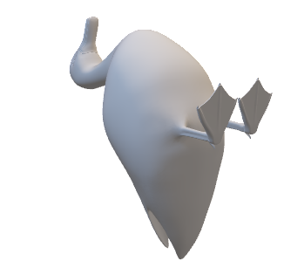
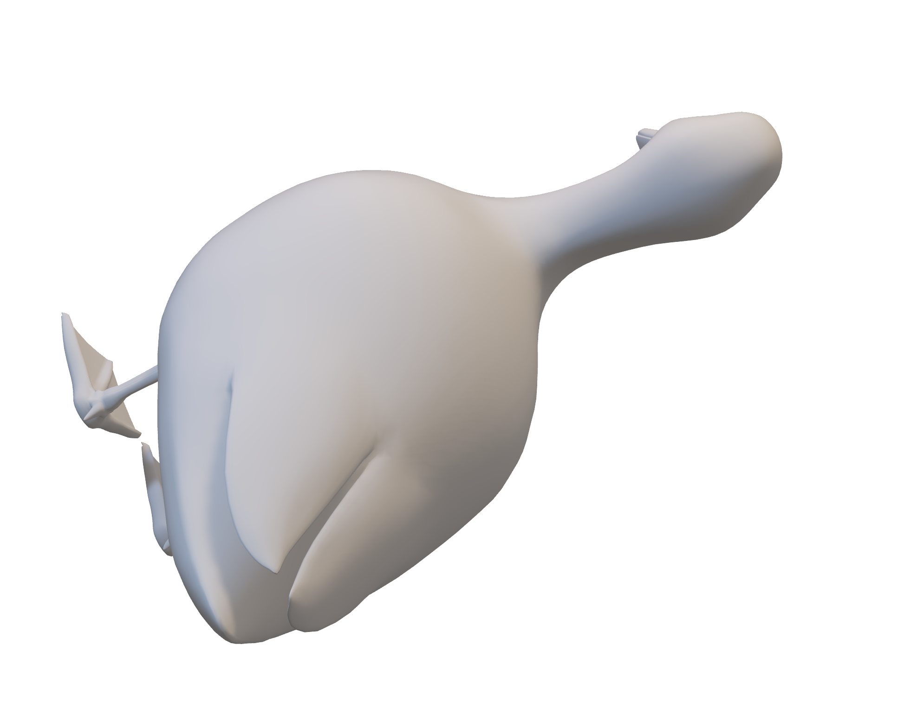
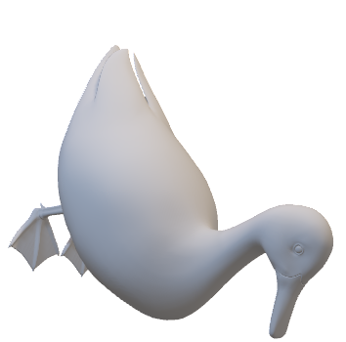

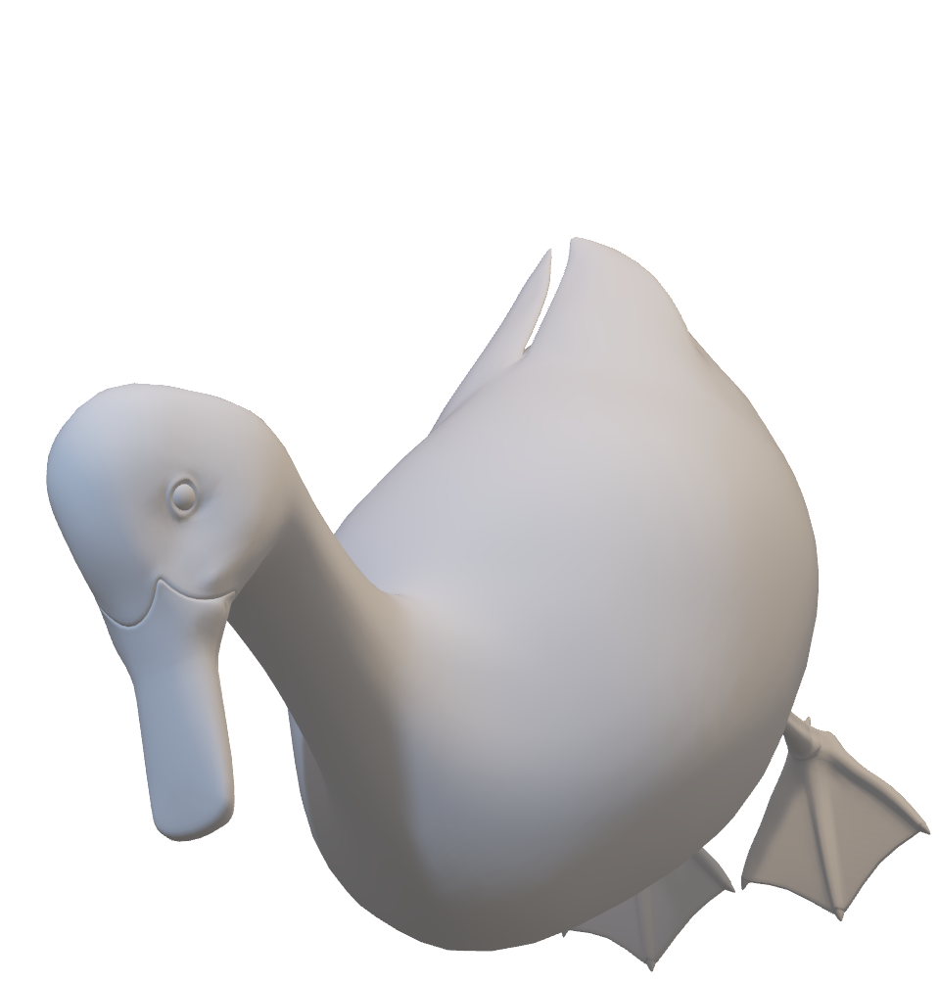
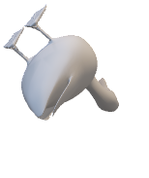
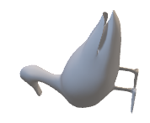
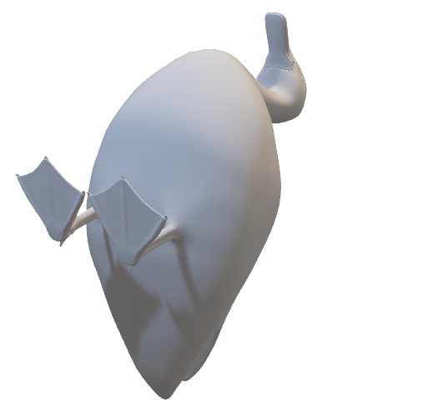
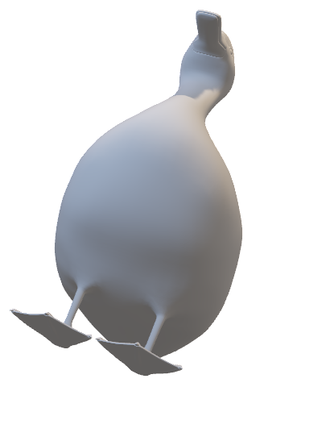
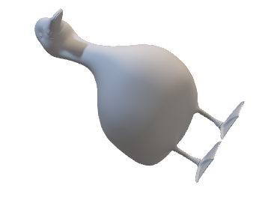
Building Visualizations with three.js
Pat Dolan

Slide 2
What the heck is three.js?
Three.js is a popular, lightweight, open-source JavaScript library used to create and display 3D graphics in a web browser using WebGL (Web Graphics Library). It simplifies the process of working with 3D graphics by providing an easy-to-use API that handles complex WebGL programming behind the scenes.

Slide 3
Well then what the HECK is WebGL?
WHO CARES
WebGL (Web Graphics Library) is a JavaScript API that allows you to render interactive 2D and 3D graphics within compatible web browsers without requiring plugins. It is based on OpenGL ES (Embedded Systems), a widely used graphics standard for mobile and embedded devices.

Slide 4
Examples
THREEJS
Penderecki’s Garden
Mother’s Day
Bruno Simon
…me

Slide 5
What are we even doing here?
Basic project structure
Renderer
Resizer
Scenes
“Game” Loop
Camera
Etc.
Meshes/geometries
Positions/rotations
Basics/Imports
Materials/Textures
Basics/Imports
OH NO
SHADERS!
Shaders
Vertex
Fragment
Lighting
Directional/Ambient
Post Processing
Effect Composer
Custom Shaders
User Input
Raycasters
HTML integration

Slide 6
What even AREN’T we doing here
I’m just one small duck…
Animations
Skinning/Rigging
Environment Maps
Bumpmaps
Text
Instancing
Layers
Physics
Geometry Buffers
Frame Buffers
Three-React-Fiber
Etc..

Slide 7
Stuff you need
PATIENCE
Basics of frontend and Typescript
Node/npm/npx
Chromium based browser
VS Code (ideally)
~C R E A T I V I T Y~

Slide 8
Gettin’ IN IT
I’ll CRY
npx degit PatrickDolanJ/basic-three
npm install
npm run dev

Slide 9
Tooling
THREE Dev tools
Chrome extension
Scene tree visualization
Make sure GLSL vite plugin is working
Spectorjs
Chrome extension
Graphics program debugging
FPS meter in chromium
Control/command + shift + p -> FPS

Slide 10
Additional Libraries
Three-Custom-Shaders
keep the base THREE shaders and add our own on top
GSAP
simple animations
Three-BVH-CSG
3D Boolean operations [not included][but sooo cool]
Troika-Three-Text
Text direct from .tff or .otf directly

Slide 11
Resources
THE DOCUMENTATION and the SOURCE CODE
Three-custom-shader documentation
Official Examples
YouTube -> Yuri Artiukh
LLMs…I GUESS

Slide 12
System
World
Basically main
Everything in the constructor
Scene
Sort of like a level in video games
Camera
How to view the scene
Renderer
How THREE will render, usually just WebGL but there are options
Shadowmaps and other settings
PostProcessing
Loop
Main ”game” loop
Interfaces for interactables and updateables
User inputs
Raycasters etc.
OrbitController
Simple camera controls
Not always the best solution
Resizer
Keeps the projection matrix
up to date

Slide 13
World
World.ts
We will cover all the parts but for now this is essentially your main.
All setup happens in the constructor (it doesn’t have to)
Acts as the interface to outside of THREE
Start -> initiates the game loop (sooooon...)
Stop -> (not used here actually)

Slide 14
Main
main.ts
Is just instantiating world once the DOM loads
And then calling start which kicks off our “loop”

Slide 15
Helpers
World.ts
Helpers are just ways to visually debug essentially
Axes helper shows the X,Y,Z coordinates
DirectionalLight helper shows the….directional light size and orientation

Slide 16
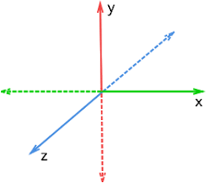
Coordinates in THREE

Slide 17
Scene
Scene.ts
Think of it as a level in a video game
Contains all your…stuff
Background Color
Fog
THREE.Color()?

Slide 18
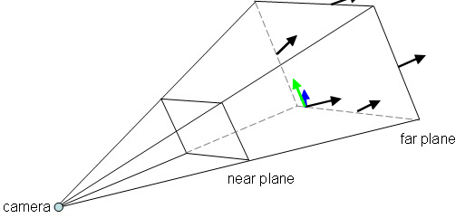
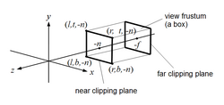
The Camera
PerspectiveCamera.ts
Frustum
Types of Projection
Orthographic
Perspective

Slide 19
OrbitController
OrbitController.ts
One of the THREE ”add-ons”
Must be imported separately
Additional fun options

Slide 20
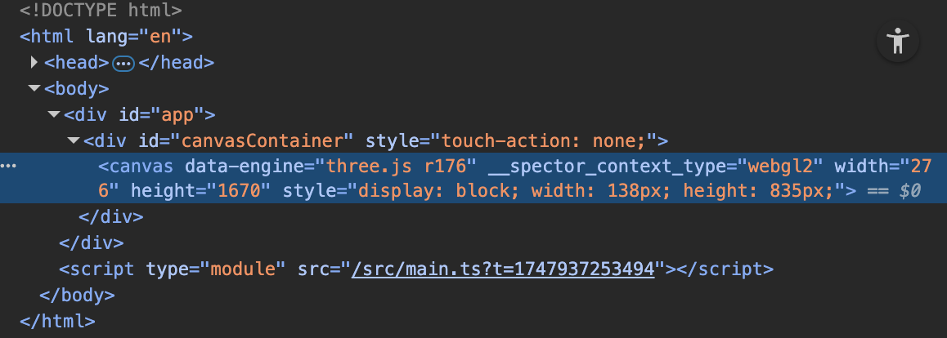
Renderer
Renderer.ts
WebGLRenderer
Settings
ShadowMaps
AntiAliasing
Etc.
Post Processing
Utilize THREE’s Effect Composer
Essentially a set of shaders for the whole screen (sometimes)
We’ll talk about the custom shaders later

Slide 21
Resizer
Resizer.ts
Simply updates the projection matrix for the camera with the new aspect ratio of the window

Slide 22
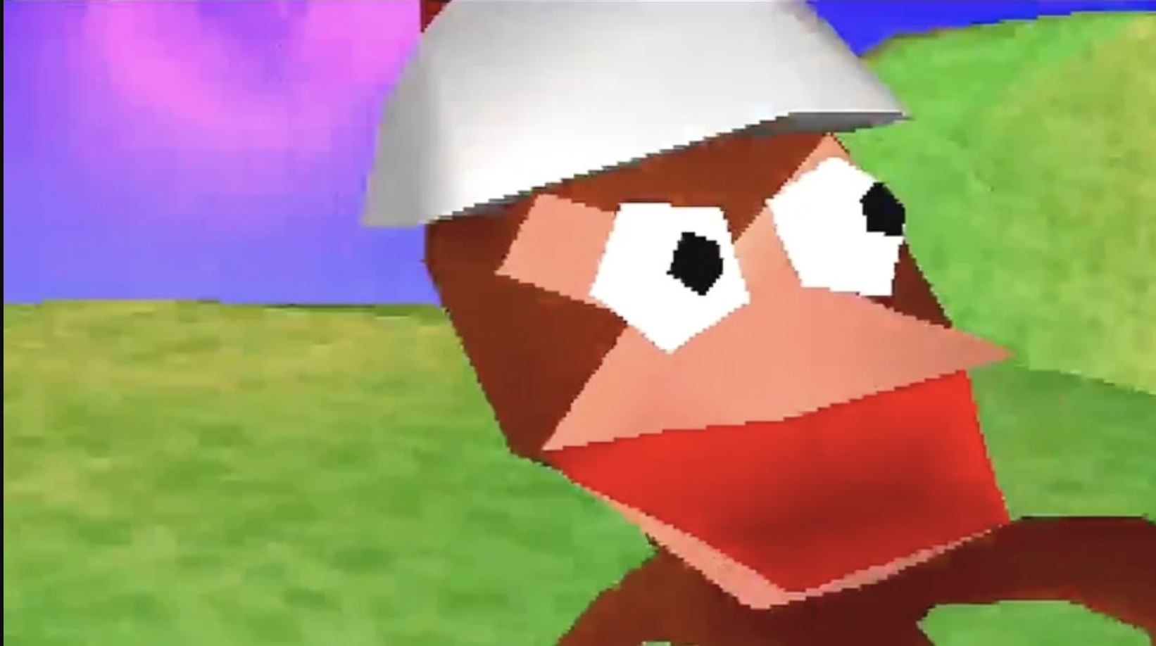
Tales from the LOOP
Loop.ts
Backbone of the project
Main “loop” -> update()
Clock.getDelta()
Fixed Time Interval
Max Time Interval
Start and Stop
integration with the rest of the site
Interfaces
Update
Click/Hover -> Hover States

Slide 23




Take it in

Slide 24
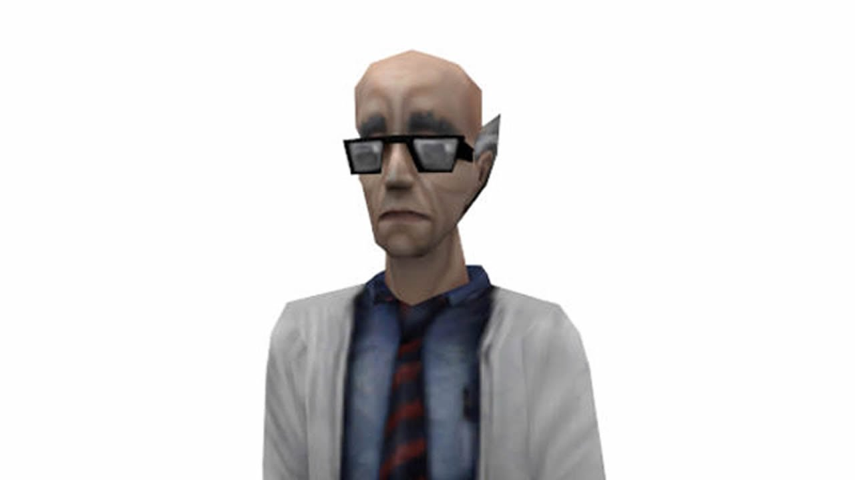
OK

Slide 25
Components and Example Stuff
Meshes
Materials
Textures
Geometries
Lighting
SHADERS

Slide 26
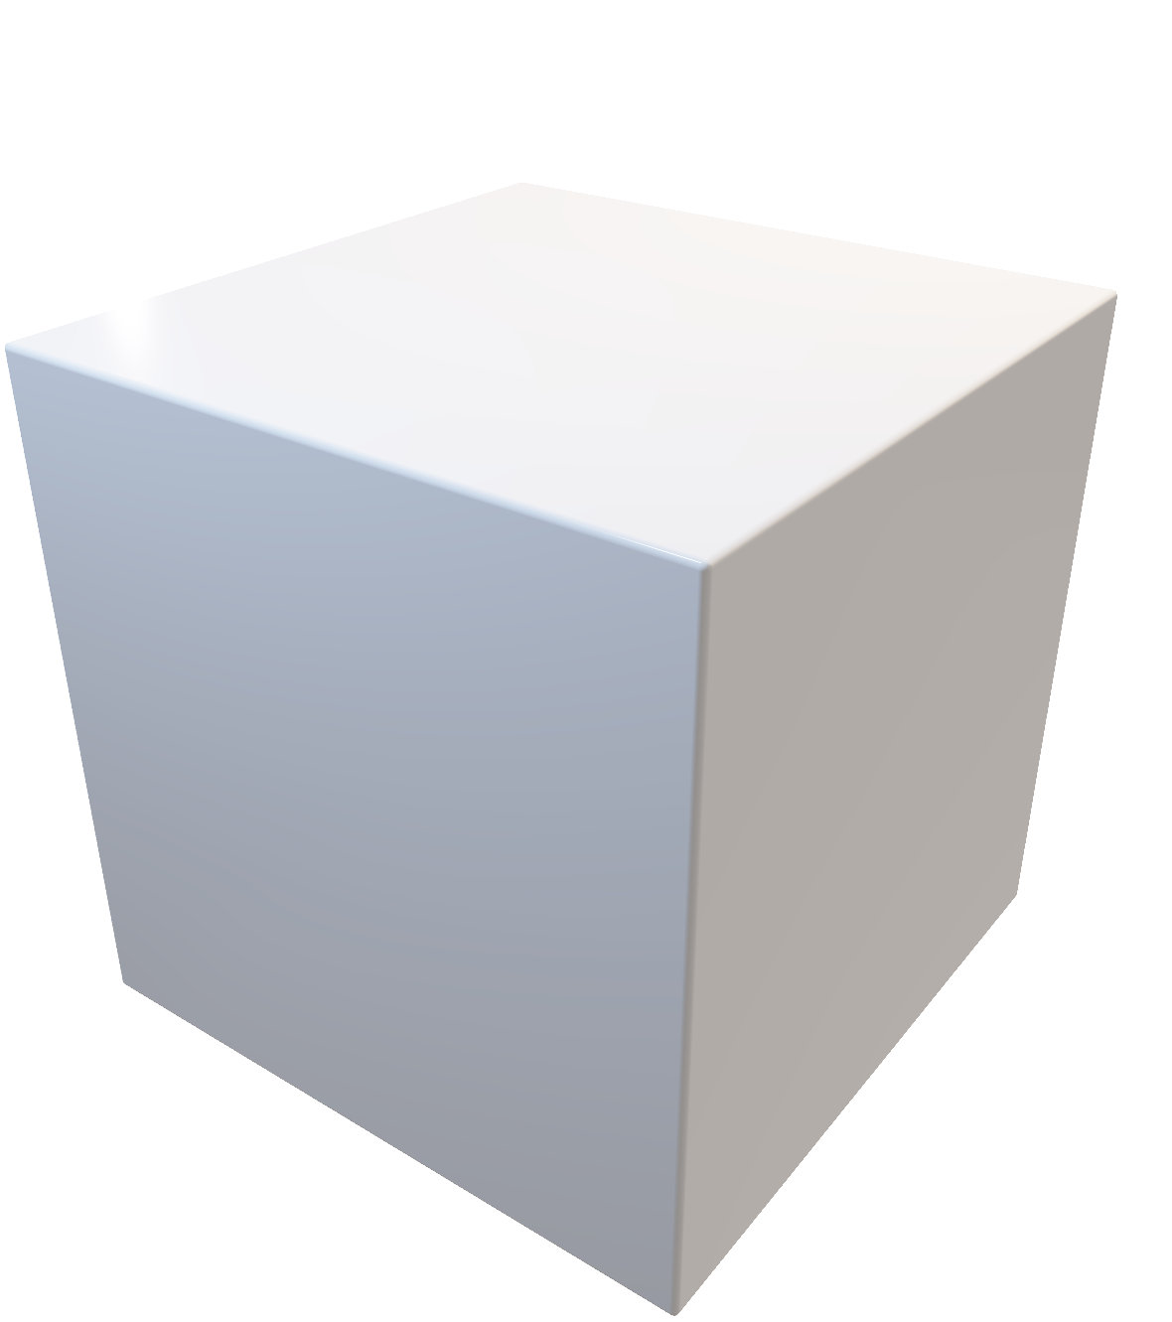
THE CUBE (Meshes)
StarterCube.ts
Two Main Components
Geometry
Basic Shapes (Documentation)
Material
Properties (type dependent)
Shaderssssssss (later)
Size,scale,position and rotation
Interfaces with interactables/update

Slide 27
Geometries
THREE calls basics PRIMITIVES
Box, Sphere, Torus etc.
Wireframes use Wireframe Geometries (not covered here) -> And then LineSegments instead of Mesh
Points for point clouds and the like
Hand coded geometries can be achieved through BufferGeometries (not covered here)
Imported 3D models we will cover later

Slide 28
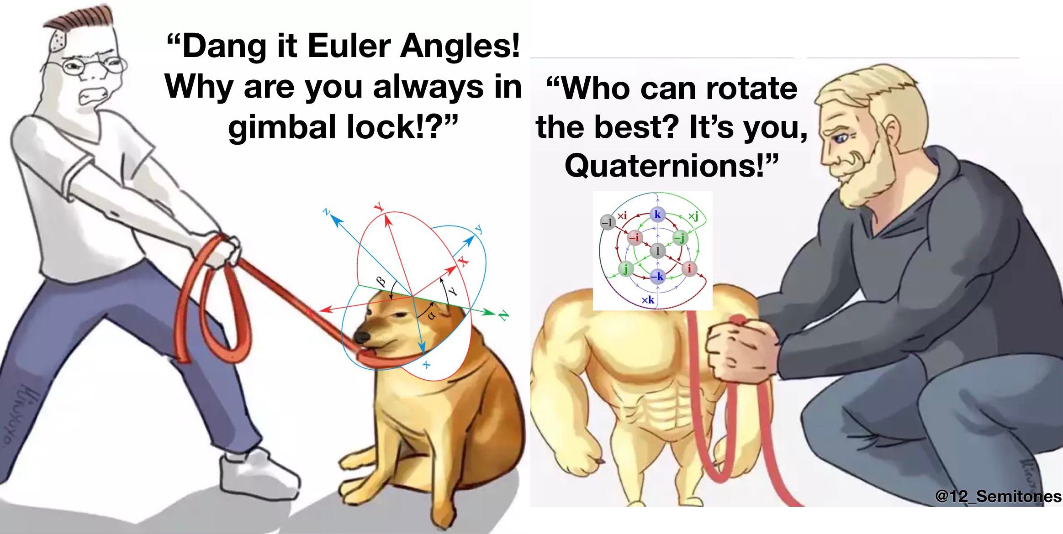
Rotations in 3D
Note that THREE expects Quaternions to be normalized.
Euler
X,Y,Z
Quaternions
X,Y,Z,W
THREE uses quaternions under the hood
Due to the definition of Euler angles there is a mathematical singularity when the object longitudinal y ₀-axis is pointed up or down (i.e. pitch approaches ±90°). This singularity is not present in the quaternion or directional cosine matrix (rotation n matrix) presentation.[GIMBAL LOCK]

Slide 29
Materials
Essentially how to style your geometries
MeshBasic -> basic, flat
MeshStandard -> physically based lighting (more expensive)
MeshPhong -> non physically based (cheaper)
Custom -> we will cover when we get to shaders
Each type of material has different parameters and use cases. How they interact with light, ambient colors, fog etc.
We will cover BasicMaterial.ts in a bit

Slide 30
Let’s make a new Object
World.ts
Make a new Geometry first (any primitive)
Make a new Material (any of the three previously mentioned)
Make a new Mesh
Set its position
Add to scene

Slide 31
Example
wow-ee
const geo = new BoxGeometry(width,height,depth);
const mat = new MeshBasicMaterial(new THREE.Color().setRGB(r,g,b));
const mesh = new Mesh(geo,mat);
mesh.position.set(x,y,z);
this.scene.add(mesh);

Slide 32
Now let make it interactive
Instead make a new Class in Components
Interface with either the hover or click
Hoverable, Clickable
Do SOMETHING
Size, scale, color, SHWATEVER

Slide 33
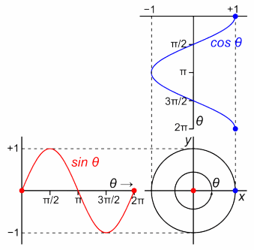
Sine and Cosine
Convenient for “back and forth” type motion
Works well with performance.now(), but not deltaTime
Keep in mind the magnitude of the input milliseconds vs seconds etc.

Slide 34
GSAP
Easy animations
I won’t cover here but, in my experience, plays nicely with THREE
Try it out if you feel like being COOL AS HELL

Slide 35
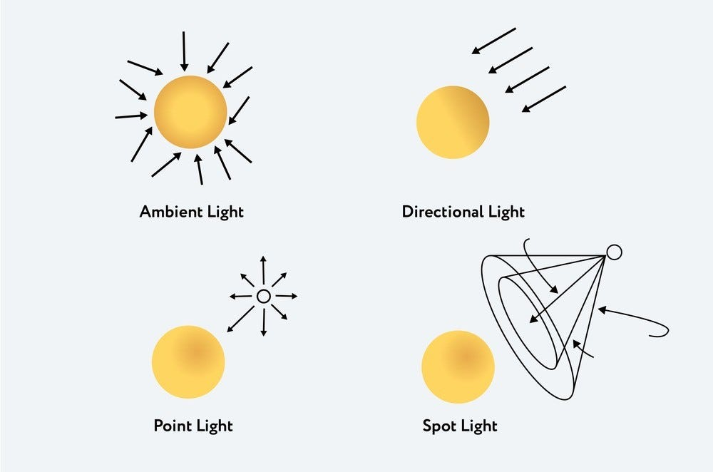
Lighting
Ambient
Directional
Hemisphere
Point
RectArea
Spot

Slide 36
Directional etc.
DirectionalLight.ts
To achieve shadows, a few things need to happen
The renderer needs ShadowMaps enabled
The object needs to be able to cast shadows
Generally, mesh.castShadow=true;
And in order to receive shadows
mesh.receiveShadow=true;
A lot of settings in here (ignore for now except for radius, and far, near, left and right
These have some part to play on the softness and the area the light will cover

Slide 37
3D Model Importing
Duck.ts
Loads async, so need to keep that in mind. Modifications needs to happen AFTER it loads
OBJ files have a a few components
duck.jpg -> texture
duck.mtl -> material
duck.obj -> the vertices/objects and how to apply material
OBJ files can have multiple “objects” and multiple “materials/textures”
THREE treats them as a Group
Each model needs to sort of be treated individually

Slide 38
Other Types of 3D Model Files
GLTBLoader -> preferred but maybe less ubiquitous
Can contain everything from textures to lights to animations
3DM -> Rhino files
DRACO -> Draco compressed files
LDraw -> Lego files??
Etc.

Slide 39
Try importing another custom Object
https://free3d.com/3d-models/
Make sure its an OBJ
Place in public

Slide 40
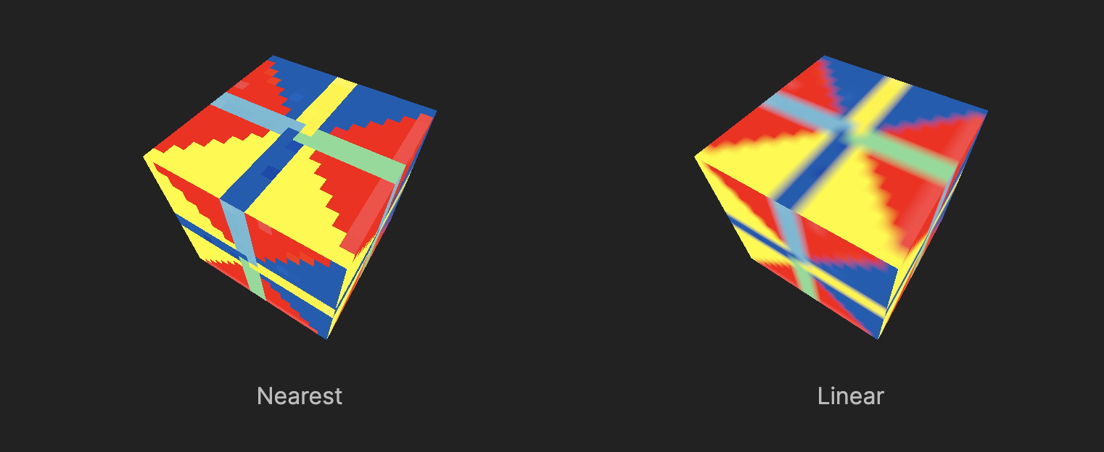
Textures
TexureSphere.ts
Also load textures async
Be careful how they will apply (top of sphere)
Textures are very memory expensive
textures take width * height * 4 * 1.33 bytes of memory.
Type of filtering is important
Linear vs Nearest etc.

Slide 41
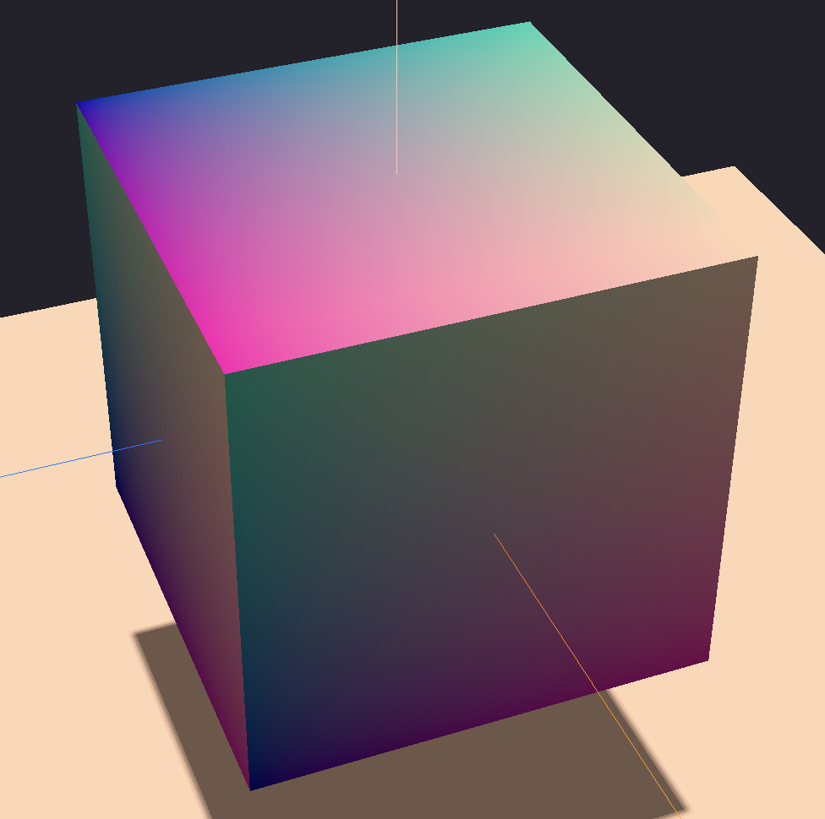
What are UVs?
U and V are the 2D axes (like X and Y in 3D space) used to define how a flat image (texture) wraps around a 3D mesh.
UV mapping is the process of "unfolding" a 3D model into 2D space so textures can be applied accurately.

Slide 42
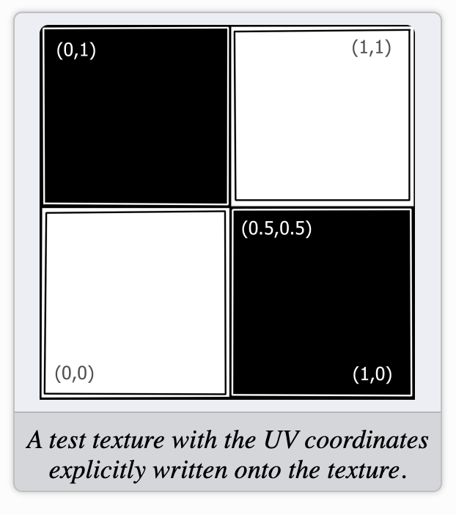
UVs cont.
THAT WAS A SHADER
BasicMaterial.ts
BasicFragment.glsl
csm_DiffuseColor is taking these values and mapping them to the output color which produces the gradient effect

Slide 43
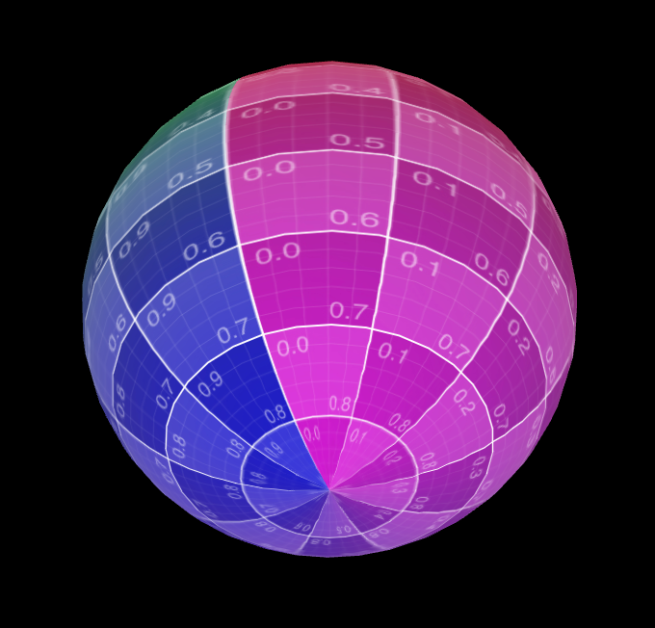
UVs of a Sphere
Textures will warp at the poles
There are ways around this, but we won’t cover them here

Slide 44
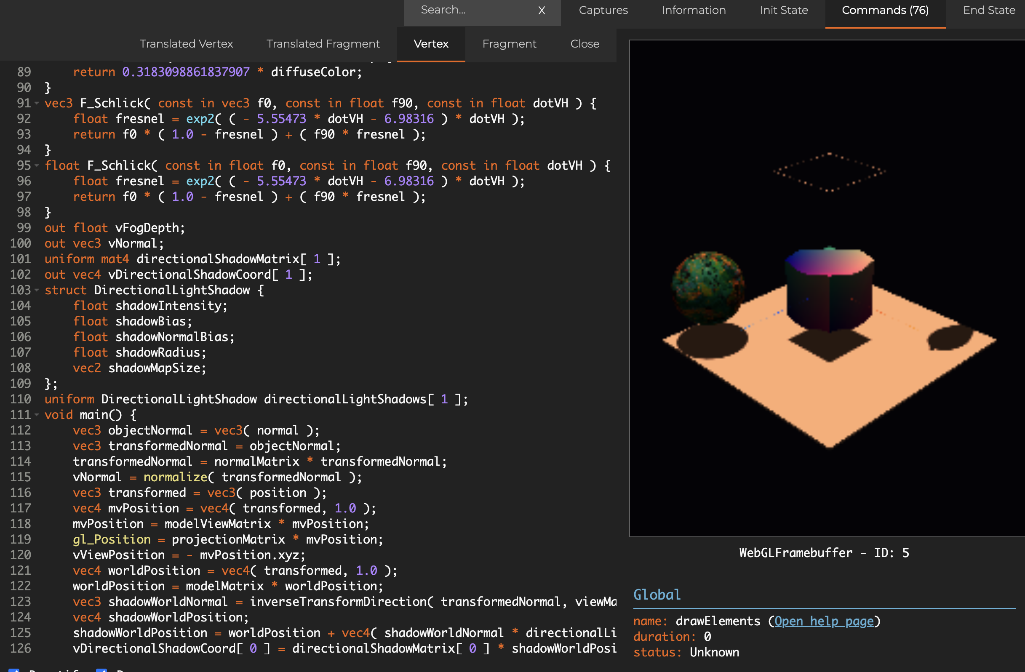
Custom Materials
Three is doing a ton of stuff under the hood to render our scene
Spector.js
Take a look

Slide 45
Custom Material cont.
There isn’t an example here, but if you were to use the default method to add your own SHADERS you would nuke all the nice things that THREE is doing for you and rebuild them by hand
ShaderChunks
Therefore, we utilize the library THREE-CUSTOM-MATERIAL and work in their framework instead
This means instead of modifying gl_Position we would modify csm_Position
HAVE to look at their documentation

Slide 46
Hold up what even is a Shader
A shader is a small program that runs on the GPU (Graphics Processing Unit) and is primarily used to control how graphics are rendered in real-time. Shaders define how objects are colored, lit, and transformed on the screen.

Slide 47
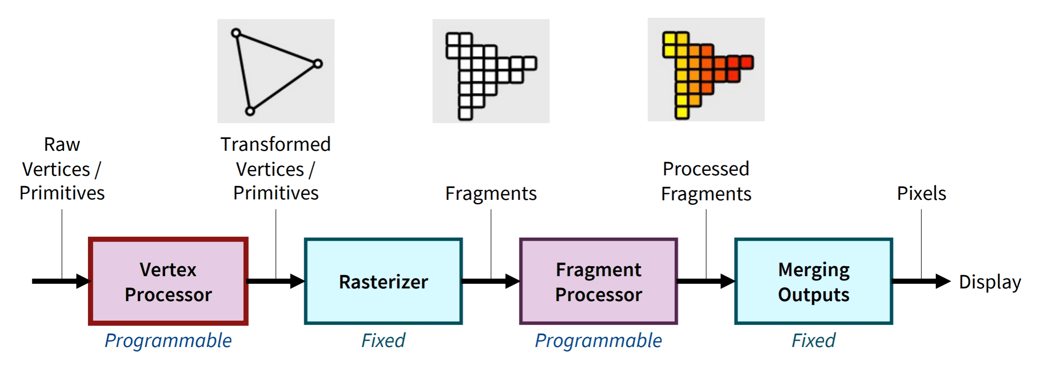
Shaders

Slide 48
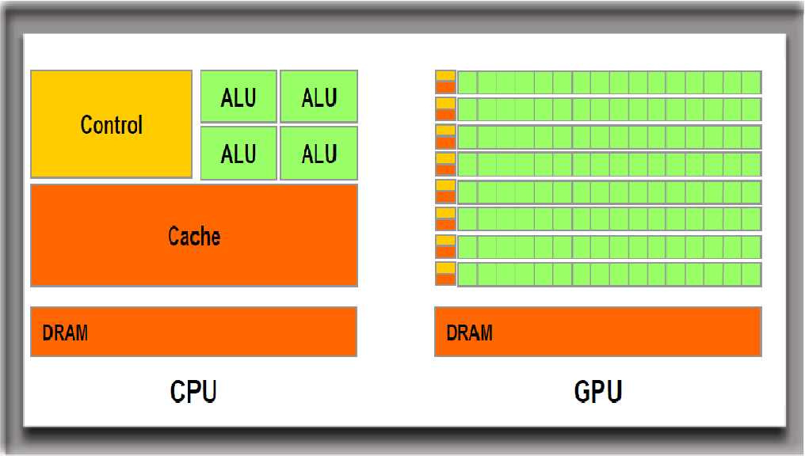
Quick detour into HARDWARE
When we write a shader, we are writing a program that runs in PARALLEL for all vertices and pixels
Each program doesn’t know about the others

Slide 49

CPU vs GPU

Slide 50
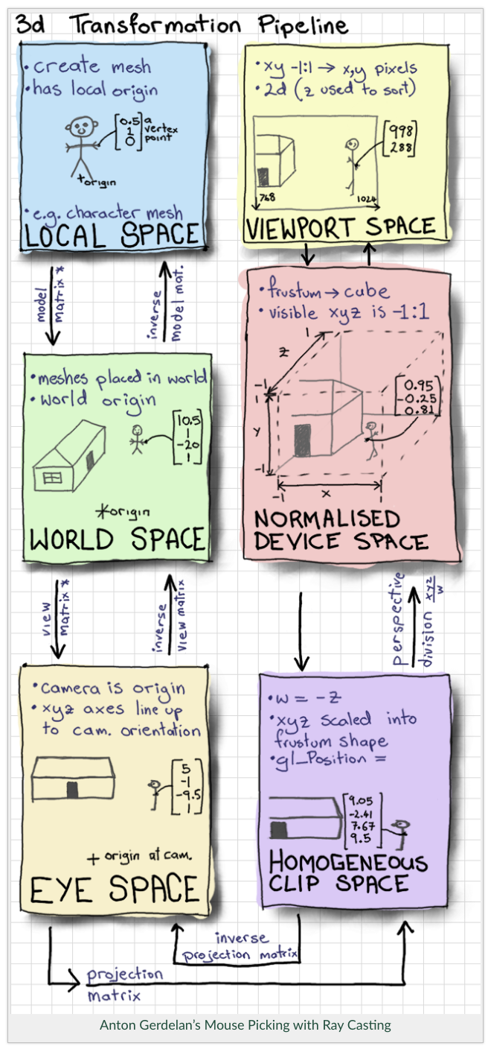
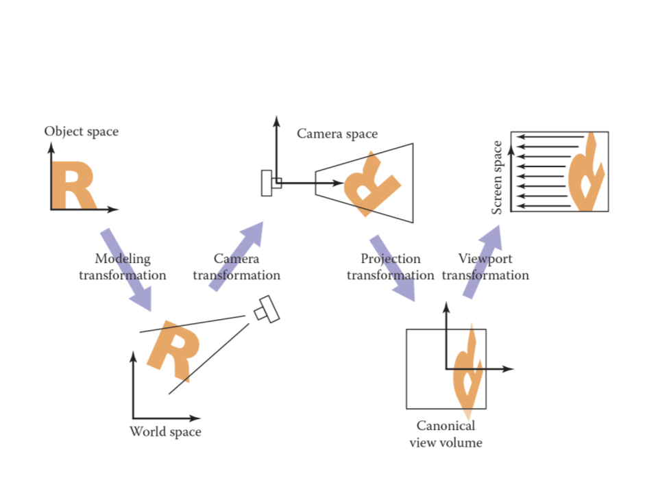
3D Pipeline

Slide 51
Shader Inputs
Uniforms -> same for every vertex/fragment
uTime
Varyings -> different for every vertex/fragment
Need to be passed from vertex to fragment
UV -> [u,v] aka [x,y]
Sampler2D -> Samples a 2D Buffer
Can be a texture or just data
Use texture2D to sample

Slide 52
Uniform uTime
BasicMaterial.ts
BasicFragment.glsl
WebGL doesn’t have a time counter by default
Set up uTime as a uniform in the material
Pay attention to the structure
Bring in as a uniform in the shader
Update in…update

Slide 53
Custom Post Processing
Renderer.ts
BasicPostProcessingShader.ts
BasicFragment.glsl
BasicVertex.glsl
EffectsComposer
A way to link all the shaders together (SOOOO much easier)
Replaces renderer.render() with composer.render()
Does make shader debugging more diffucult
Essentially a fragment shader for the whole screen
Try uncommenting some!

Slide 54
User Input throught HTML
Make a World.function
And sync to onClick or whatever your HEART desires

Slide 55
THANK YOU
NOW GO MAKE COOL SH*T
Ben and Highline for the space and time (SPACETIME)
Sean Dolan for help workshopping
Emma for workshopping this presentation and listening to me talk about this for weeks
Feel free to reach out with any questions @ datpoland@gmail.com

